Slide 1
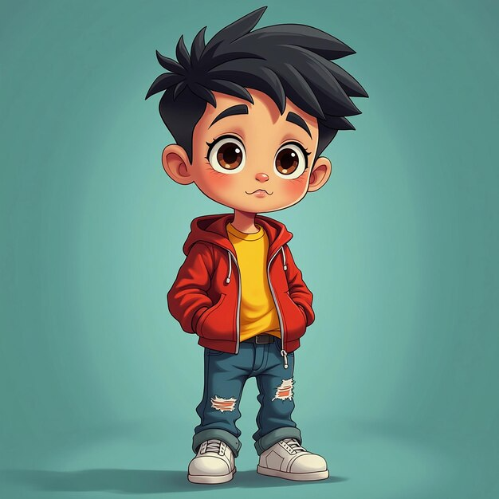
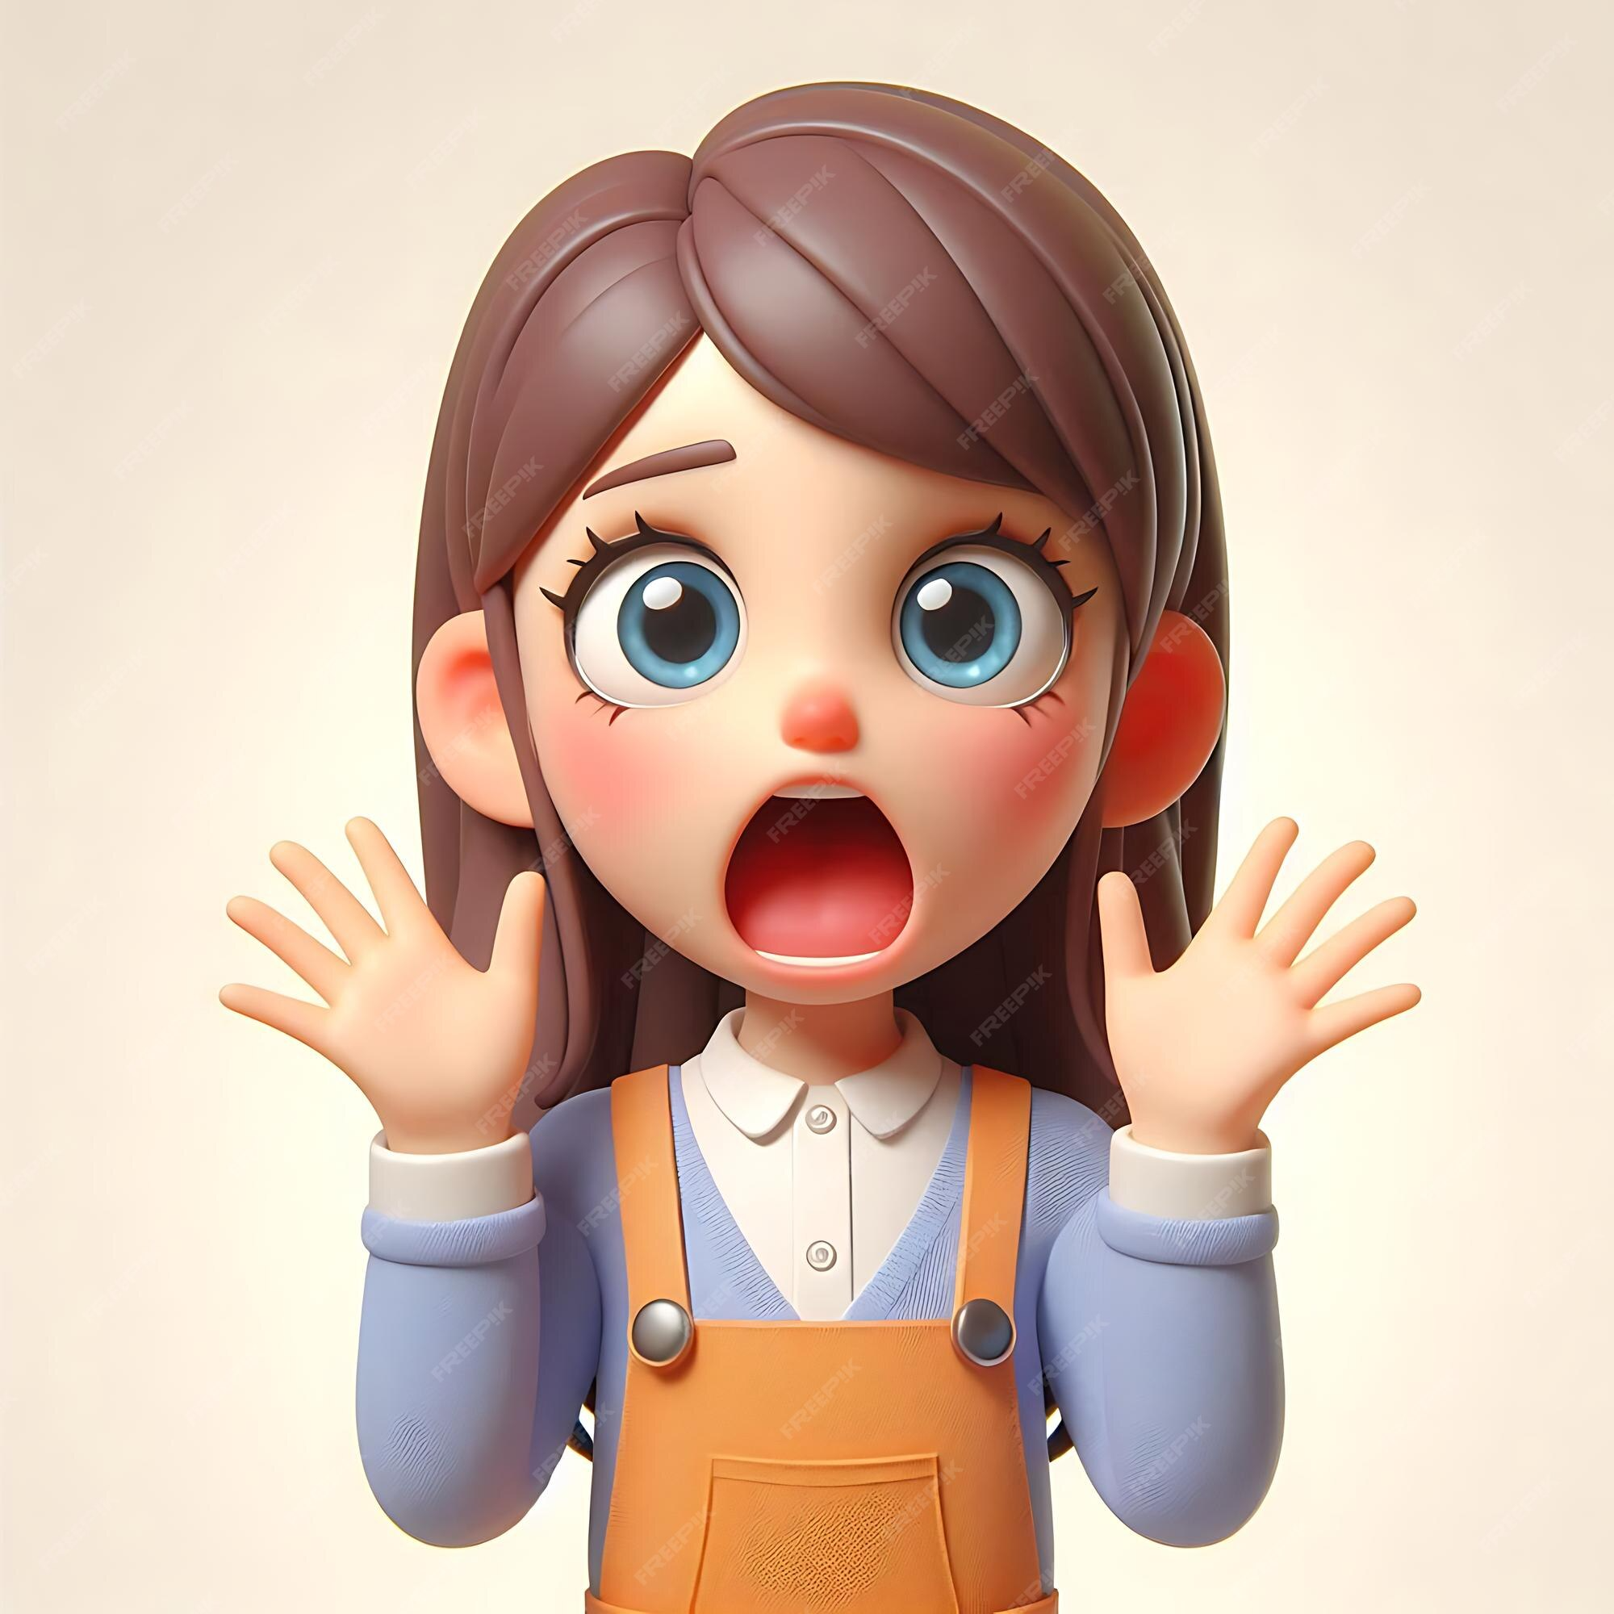
Building a Cartoon Emotion Classifier with fastai
Name: Netanel Kuchma
Course: Deep Learning – Exercise 1
Project: Image Classification with fastai
GitHub Repo: https://github.com/NetanelWDS/DeepLearningHW1

Slide 2
Problem Definition
Build a model that classifies cartoon faces into five emotions:
😊 Happy
😢 Sad
😡 Angry
😮 Surprised
😐 Neutral
Motivation
Helps autistic children practice understanding emotional expressions
Cartoon faces are simpler, clearer, and less overwhelming than real faces
Useful base model for future educational tools

Slide 3

Why This Problem?
Social-emotional understanding is challenging for some autistic children
Cartoon-based learning is widely used in therapy
No publicly available dataset matching this exact need

Slide 4
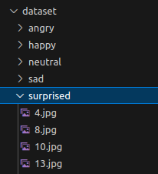
Dataset Creation
How images were collected
Used ddgs (DuckDuckGo Search API) to download images
30+ diverse queries per class to maximize variety
Downloaded ~108–133 images for each emotion
Stored in folders: dataset/<emotion>
Challenges
Many irrelevant images
Duplicate images
PNGs with transparency
Different artistic styles

Slide 5
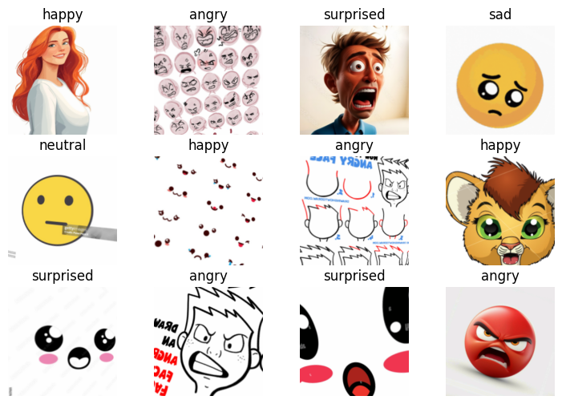
Dataset Cleaning
Cleaning Steps
Removed corrupted images using PIL
Removed duplicates using SHA-1 hashing
Converted all images to RGB
Manually inspected for mislabeled/noisy images
Final Dataset
~500–700 cleaned images
5 balanced classes
Ready for training

Slide 6
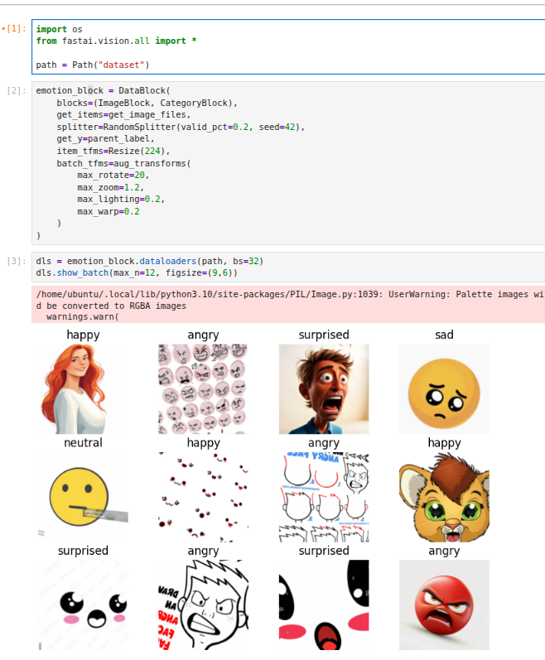
Data Loading in fastai
What this does:
Automatically loads images
Extracts labels from folders
Splits into train/valid
Applies augmentations
Prepares batches for GPU

Slide 7
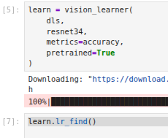
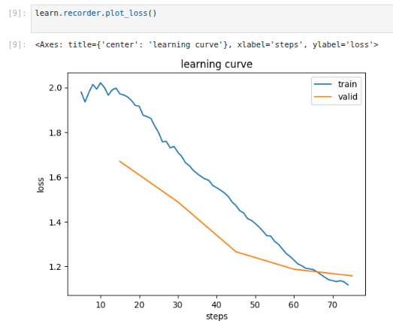
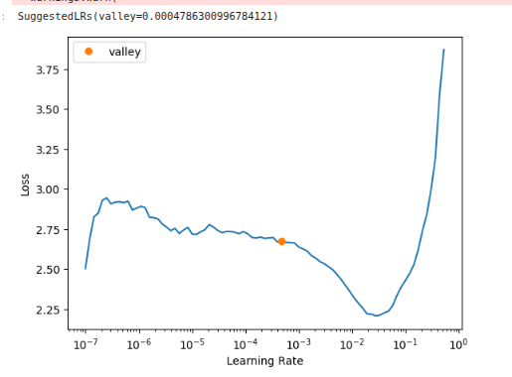
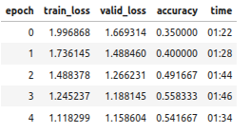

Model Training
Architecture
Transfer Learning with ResNet34
Pretrained on ImageNet
Fine-tuned for 5 emotion classes
Training Process
learn.lr_find() to choose optimal learning rate
learn.fine_tune(5) for training
Used accuracy as evaluation metric

Slide 8
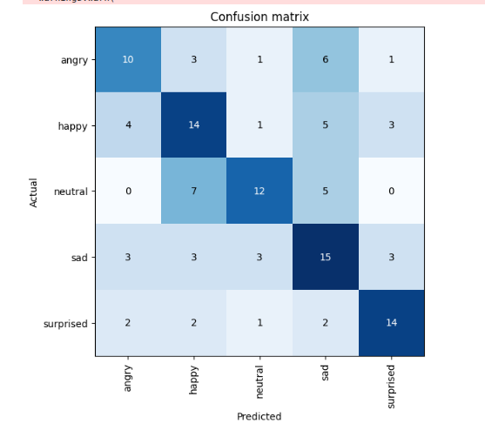
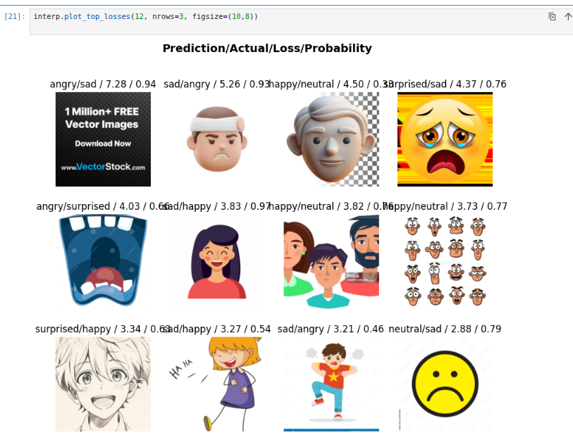
Evaluation
Model performs well on sad, surprised, and happy.
Main confusions:
Neutral ↔ Happy
Angry ↔ Sad
“Neutral” is the hardest class — often ambiguous or visually similar to mild emotions.
Errors mostly come from subtle differences in cartoon expressions.
Overall accuracy is good, with clear room for improvement in separating similar emotions.

Slide 9
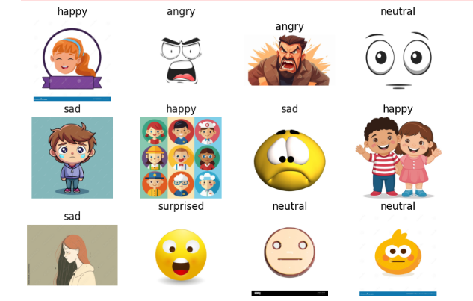
Example of good predictions

Slide 10
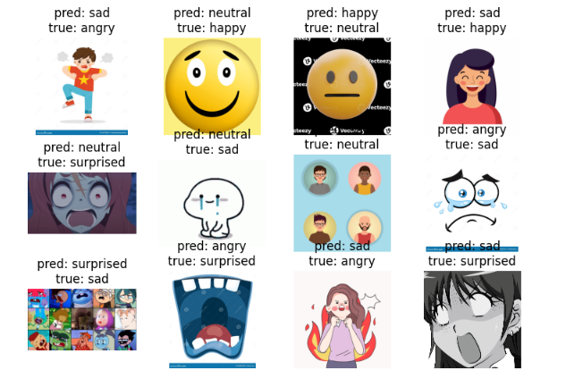
Example of bad predictions

Slide 11

Discussion of model weaknesses
Although the model performed well, several weaknesses were observed:
Ambiguous expressions Some cartoon faces contain traits of multiple emotions (e.g., neutral vs sad), making classification difficult even for humans.
High variability in artistic style , This diversity increases generalization difficulty.
Noise from web-scraped data Some downloaded images were mislabeled by search engines, despite cleaning.
Limited dataset size ~100–150 images per class is good but not large. More data would improve accuracy.

